Slide 1
Robust Optimal Entry Guidance For Future Mars Landers
Connor Noyes
Advisor: Ken Mease
Wednesday, June 2nd, 2021

Slide 2
Outline
Entry, Descent, and Landing Introduction
Motivation
Chute-Based EDL Guidance
Contributions
Main Results
SRP-Based EDL Guidance
Conclusions
Future Work
Questions and Discussion

Slide 3
Publications
Noyes, C.D., Mease, K.D., Mars Entry Guidance for High Elevation via Robust Optimal Control, Journal of Spacecraft and Rockets, 2021 (submitted for review).
Noyes, C.D., and Mease, K.D., Entry Guidance for Propellant Optimal Powered Descent Ignition on Mars, AIAA/AAS Astrodynamics Specialist Conference, 2020.
Noyes, C.D., and Mease, K.D., A Convex Optimization Approach to Mars Entry Trajectory Updating, AAS/AIAA Astrodynamics Specialist Conference, 2018.
Noyes, C.D., Wolf, A., and Benito, J., High Ballistic Coefficient Mars EDL With Supersonic Retropropulsion, AAS Guidance and Controls Conference, 2017.

Slide 4
EDL Technology
Current gen. missions rely on technologies qualified for space in the 1970s under the Viking program
Missions continue to scale the DGB parachute for larger and heavier vehicles but there are fundamental limitations to the extent they can be scaled
Future missions will rely on alternative technologies to enable manned landings requiring pinpoint (< 100 m) accuracy
Supersonic retropropulsion is one such alternative
Notes:
In my dissertation I examine entry guidance for current generation missions with a simple state feedback-based guidance, and for future missions where the entry phase sets the conditions for SRP to achieve pinpoint landing.

Slide 5
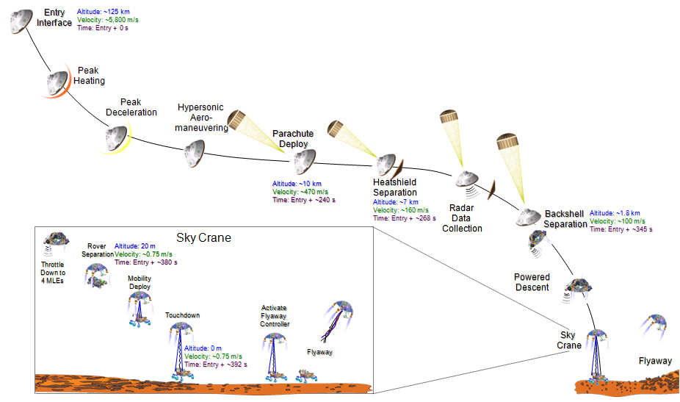
Mars EDL Sequence
Entry Phase
Notes:
For now we restrict our focus to the current generation of landers, and return to future missions near the end of the presentation.

Slide 6
Guidance Requirements
Parachute deployment required within 10 km of planned deployment point
Derived from 25 km x 20 km landing footprint req.
Parachute deployment must occur at least 6 km above the targeted site elevation
Site Elevations (MOLA)
MSL: -4.50 km
M2020: -2.56 km
Uncertainty ellipse
Entry Interface
Parachute Deploy
Deploy must occur high enough to provide timeline margin for descent and landing operations
Powered Descent
Wind drift on chute expands the ellipse
Touchdown
Notes:
In general, guidance requirements for entry are flowed backward from the following phases based on timeline margin, landing footprint, etc.
The guidance objectives are

Slide 7
Entry Guidance State of the Practice
MSL and Mars 2020 both used modified Apollo entry guidance
Low-lifting vehicles, L/D ~ 0.24, yields limited control authority
BC = m/(C_{D}*A) ~ 120 kg/m²
Decoupled longitudinal and lateral guidance
Reference trajectory designed for slow maneuvers and wide margins
Closed-loop performance evaluated via Monte Carlo
Iteration with human in the loop until requirements are satisfied
100s or 1000s of candidate reference trajectories are evaluated
Notes:
Longitudinal guidance sets the altitude and downrange performance, while lateral guidance controls the crossrange
Long guidance sets the bank magnitude, lateral sets the sign
Vehicle is underactuated with just one control and six states to control

Slide 8
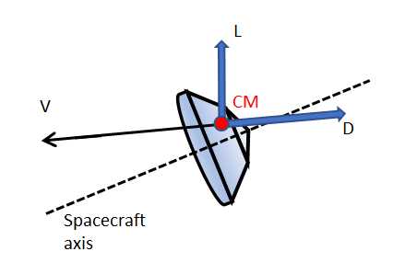
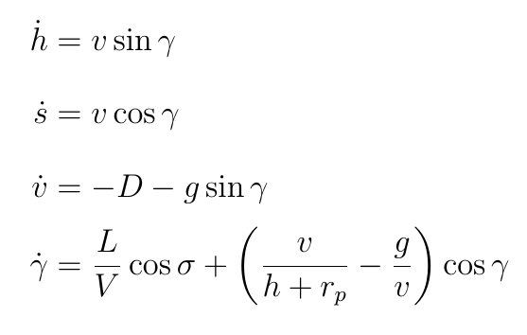
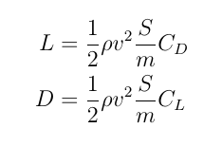
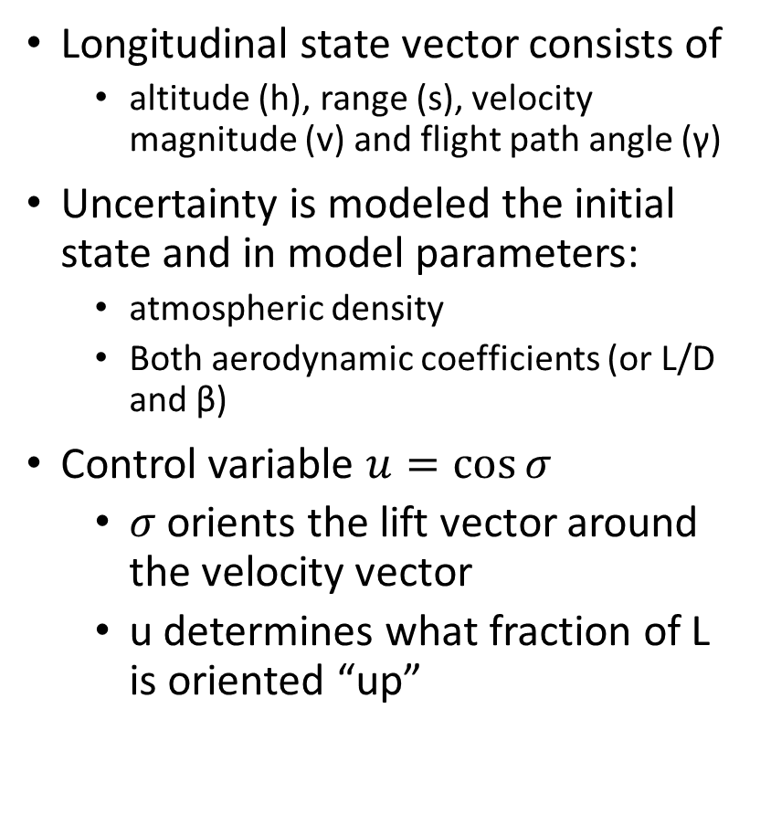
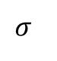
Longitudinal Motion
Longitudinal state vector consists of
altitude (h), range (s), velocity magnitude (v) and flight path angle (γ)
Uncertainty is modeled the initial state and in model parameters:
atmospheric density
Both aerodynamic coefficients (or L/D and β)
Control variable $u=\cos{σ}$
$σ$ orients the lift vector around the velocity vector
u determines what fraction of L is oriented “up”
L
$$σ$$
Notes:
Vehicle trims at a negative angle of attack (approx -15 deg)
Bank angle is the rotation of the lift vector around the velocity vector

Slide 9
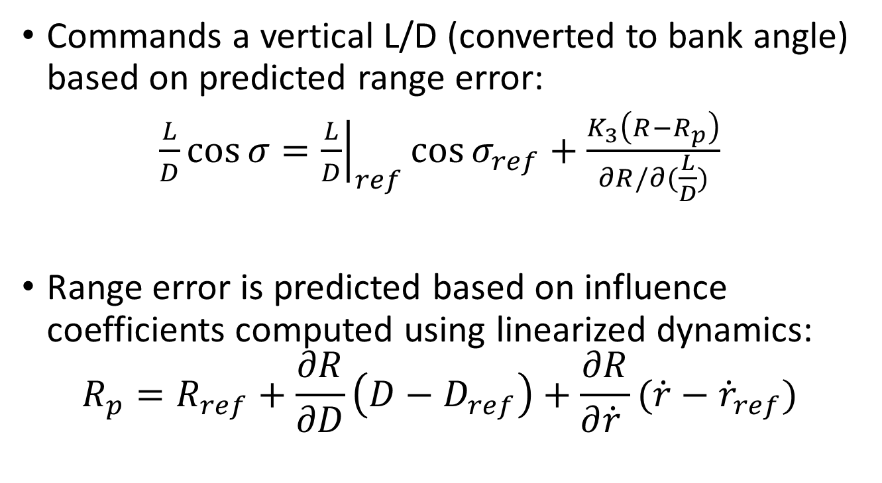
MSL Longitudinal Guidance Law
Commands a vertical L/D (converted to bank angle) based on predicted range error:
$\frac{L}{D}\cos{σ}={\left.\frac{L}{D}\right|}_{ref}\cos{σ_{ref}}+\frac{K_{3}\left(R−R_{p}\right)}{∂R/∂(\frac{L}{D})}$
Range error is predicted based on influence coefficients computed using linearized dynamics:
$$R_{p}=R_{ref}+\frac{∂R}{∂D}\left(D−D_{ref}\right)+\frac{∂R}{∂\dot{r} }(\dot{r}−{\dot{r}}_{ref})$$
Notes:
Partials are derived by backward integration of the adjoint sensitivities
K3 is the overcontrol gain used to empirically improve performance
Because the gains (except K3) are functions of the nominal trajectory

Slide 10
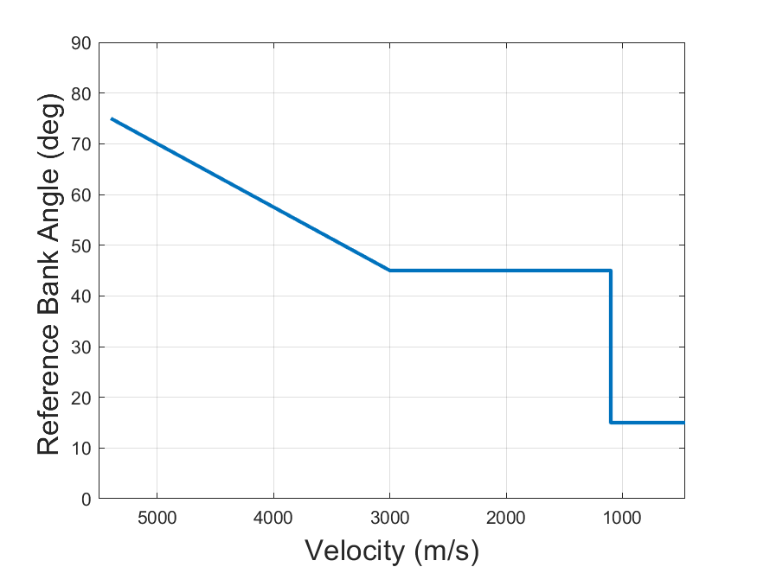
MSL Control Parametrization
Design process sweeps over parameters of the reference bank angle and the entry FPA
After selecting a combination of these parameters, additional sweeps over range error gain (K3) and other guidance parameters
Early bank angle
Late bank angle
Velocity at which late bank angle is reached
Heading
Alignment
Notes:
Show MSL parametrization, and show design map(s) created by iterating over different values of the parameters. In contrast, the weights in our parametrization make the same design map much more intuitive and in fact reduces the number of parameters to sweep over.
MSL designers imposed requirements on saturation percentage based on a rule of thumb developed by conducting many simulations

Slide 11
Motivation
The MSL guidance supported landing at -4.5 km MOLA with a 19.1 km x 6.9 km horizontal error and made the Gale Crater site feasible. The MSL guidance designers admitted that the final entry altitude could not be raised above -1 km MOLA without increasing the horizontal error.
Higher elevation landing is desired for scientific reasons and the horizontal accuracy will have to be as good or better than that achieved by MSL.

Slide 12
Goals
Using the same class of guidance control law (implementable on current hardware), design a longitudinal guidance that
Results in performance (3σ low altitude and 3σ range error) better than ETPC used by MSL/Mars 2020
Is faster (by orders of magnitude) to design, specifically by eliminating Monte Carlo in the loop
Has fewer, more intuitive parameters available to trade performance in key variables
Site Elevations (MOLA)
MSL: -4.50 km
M2020: -2.56 km
Max: 0 km
Touchdown Ellipse
MSL: 19.1 km x 6.9 km
M2020: 11.1 km x 6.4 km

Slide 13
Approach
Formalize the entry guidance objectives as a robust optimal control problem (ROCP) in which uncertainty in the problem data is treated
Moment-based statistics are used to quantify the performance
By modeling the feedback control law, optimization is performed with respect to the full closed-loop nonlinear dynamics
Noyes, C.D., Mease, K.D., Mars Entry Guidance for High Elevation via Robust Optimal Control, Journal of Spacecraft and Rockets, 2021 (submitted for review).

Slide 14
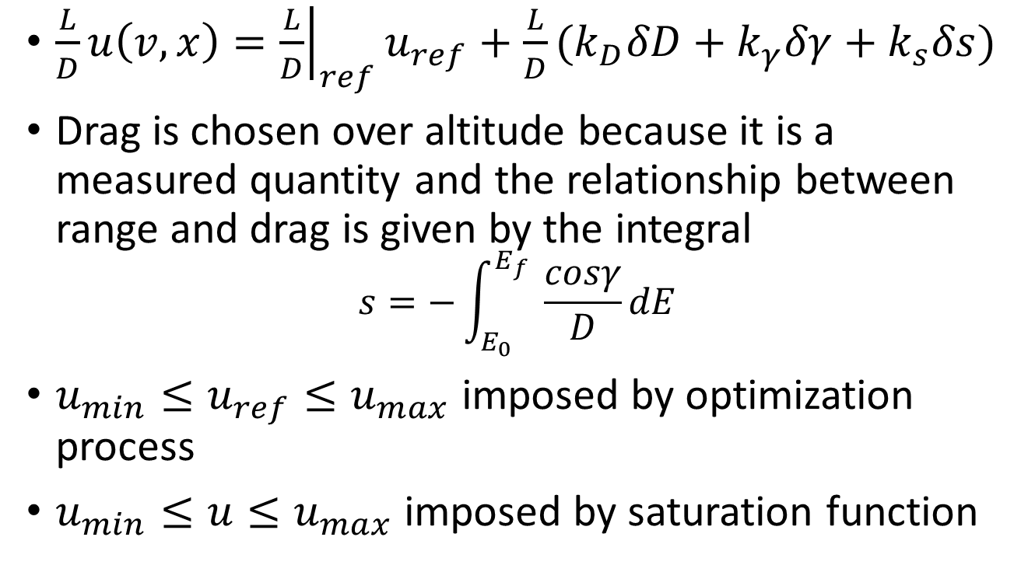
Guidance Control Law
$\frac{L}{D}u\left(v,x\right)={\left.\frac{L}{D}\right|}_{ref}u_{ref}+\frac{L}{D}(k_{D}δD+k_{γ}δγ+k_{s}δs)$
Drag is chosen over altitude because it is a measured quantity and the relationship between range and drag is given by the integral
$$s=−\int_{E_{0}}^{E_{f}}{ \frac{cosγ}{D}dE}$$
$u_{min}≤u_{ref}≤u_{max}$ imposed by optimization process
$u_{min}≤u≤u_{max}$ imposed by saturation function
Notes:
Edot = -VD, cubic in velocity and exponential in altitude through density
FPA chosen to work better with

Slide 15
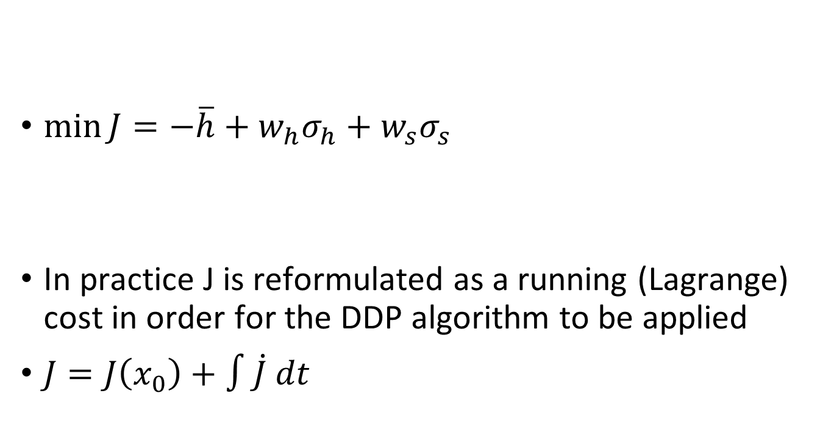
Performance Index
Raise the entire altitude distribution
$\min{J}=−\overline{h}+w_{h}σ_{h}+w_{s}σ_{s}$
In practice J is reformulated as a running (Lagrange) cost in order for the DDP algorithm to be applied
$J=J\left(x_{0}\right)+∫\dot{J} dt$
Reduce terminal dispersions in altitude and range

Slide 16
Numerical Solution Approach
Initial attempts involved linear covariance propagation and off-the-shelf optimal control software (GPOPS-II)
Increasingly difficult as problem dimension increases
ROCP literature notes the difficulties as well, low # of time discretizations (N=10-20) are often applied to cope
Robust optimal control problem is converted into a larger deterministic problem via the unscented transform
The deterministic problem is solved via control-limited differential dynamic programming
Notes:
Poor sparsity due to coupling of sigma point trajectories
Careful scaling of covariance states

Slide 17
Unscented Transform
Constructs mean and variance from transformed “sigma points” rather than propagate moments directly
Uses the full nonlinear dynamics
For a ROCP with n uncertainties, there are 2n+1 sigma points and the resulting deterministic OCP features (2n+1)n state variables
Notes:
Many reasons why UT is preferred to linearization, another is because any time there is significant saturation, the true distribution is becoming more asymmetric.

Slide 18
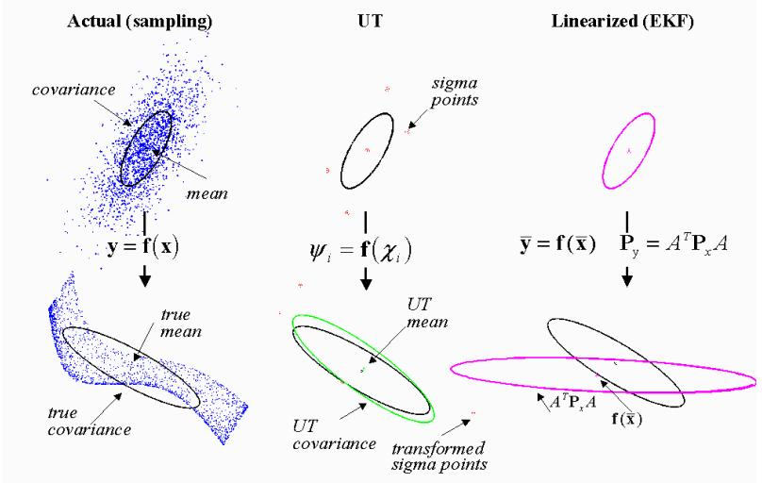
Unscented Transform

Slide 19
Differential Dynamic Programming
Based on Bellman’s Principle of Optimality
Solves N small problems (quadratic programs in m control variables) compared to nonlinear programming methods (e.g. SQP) that solve a single large-scale problem across N time points, n state variables, and m controls
Our particular problem results in 78 state variables; DDP solves the OCP in < 5 min (on average) and is insensitive to the trajectory used to initialize the optimization

Slide 20
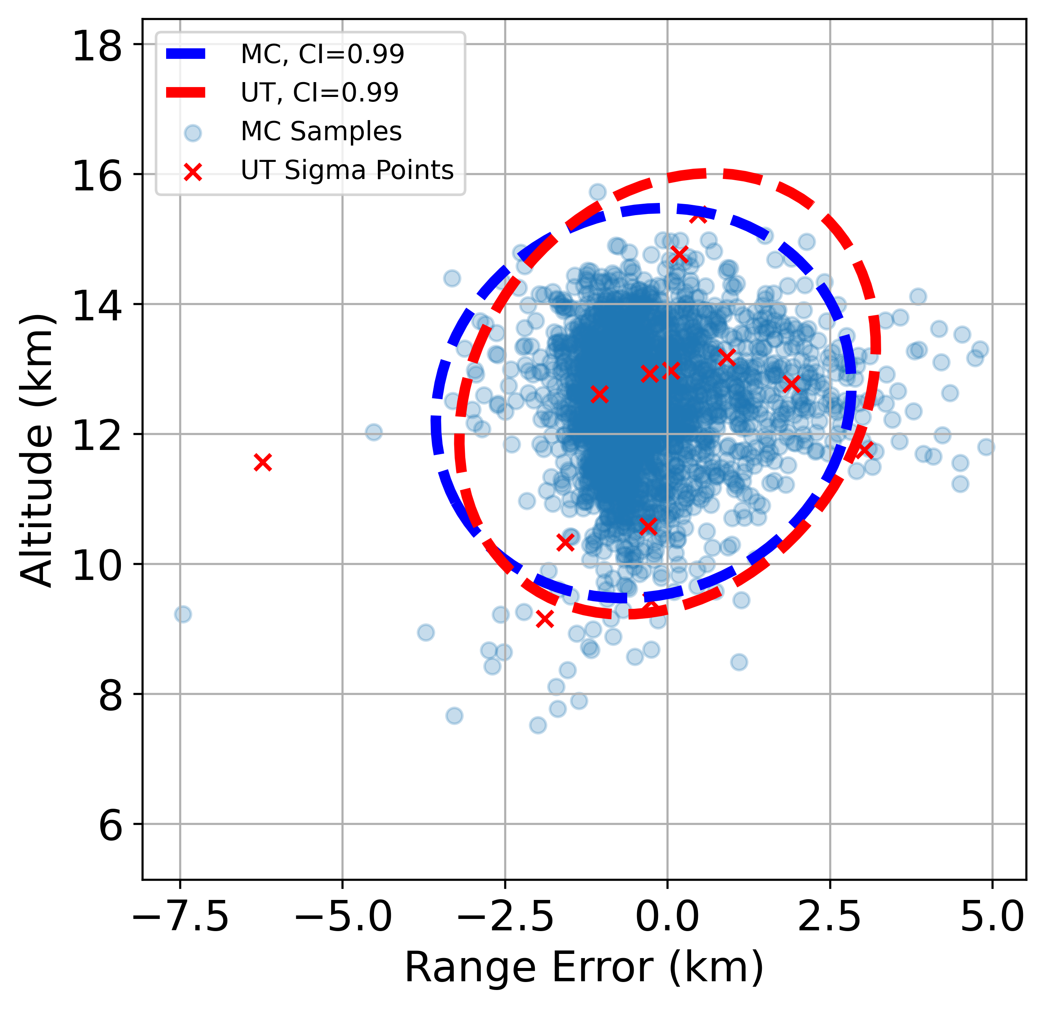
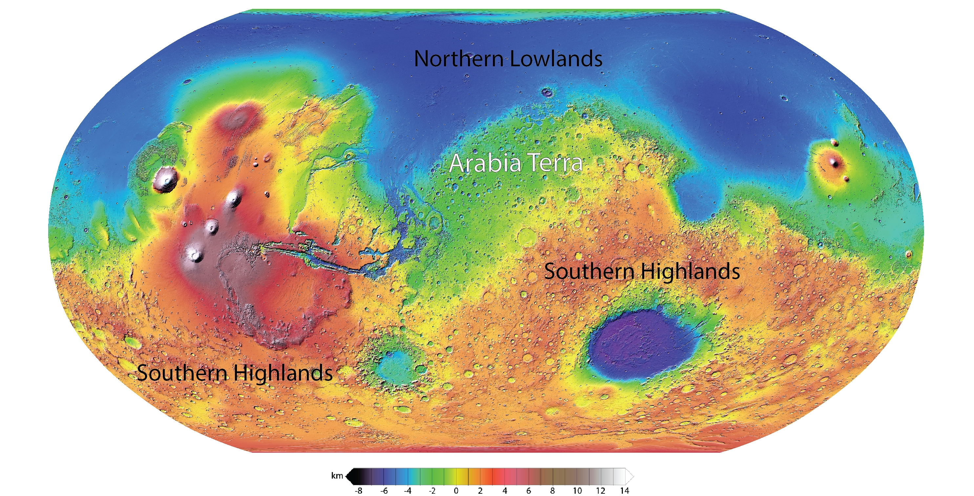
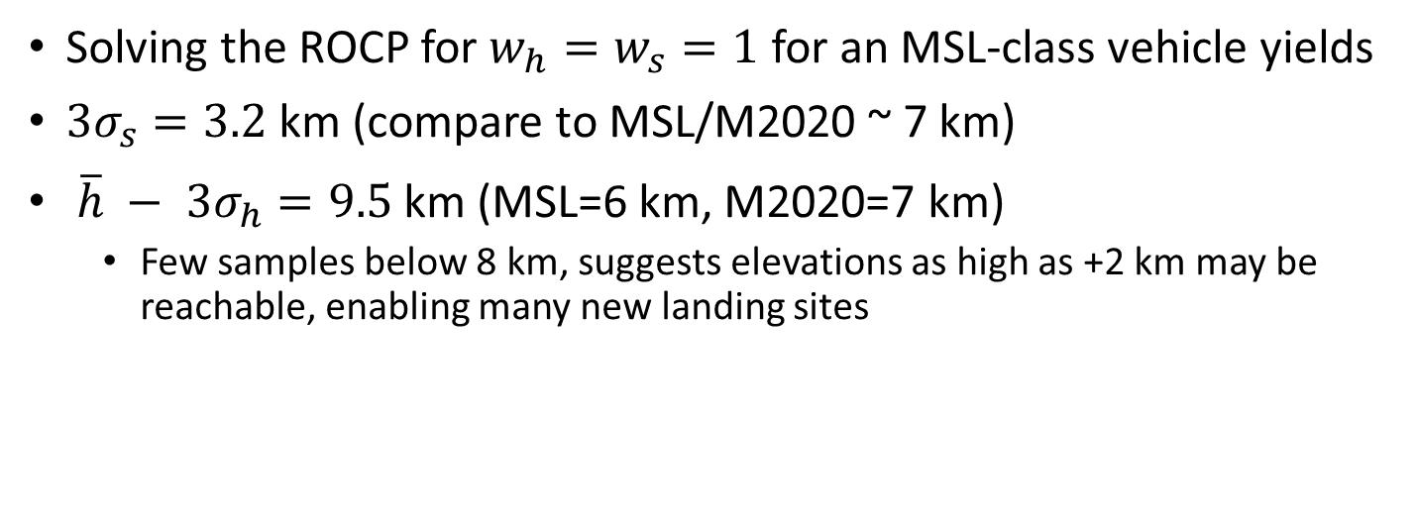
Main Results
Solving the ROCP for $w_{h}=w_{s}=1$ for an MSL-class vehicle yields
${3σ}_{s}=3.2$ km (compare to MSL/M2020 ~ 7 km)
${ \overline{h} − 3σ}_{h}=9.5$ km (MSL=6 km, M2020=7 km)
Few samples below 8 km, suggests elevations as high as +2 km may be reachable, enabling many new landing sites
99% confidence ellipses
M2020, -2.5 km
MSL, -4.5 km
Notes:
Sites like Terra Sirenum in the Southern Highlands
Also looked at solutions for a heavier class vehicle for the next Mars mission (which will bring the samples collected by Perseverance back to Earth)

Slide 21
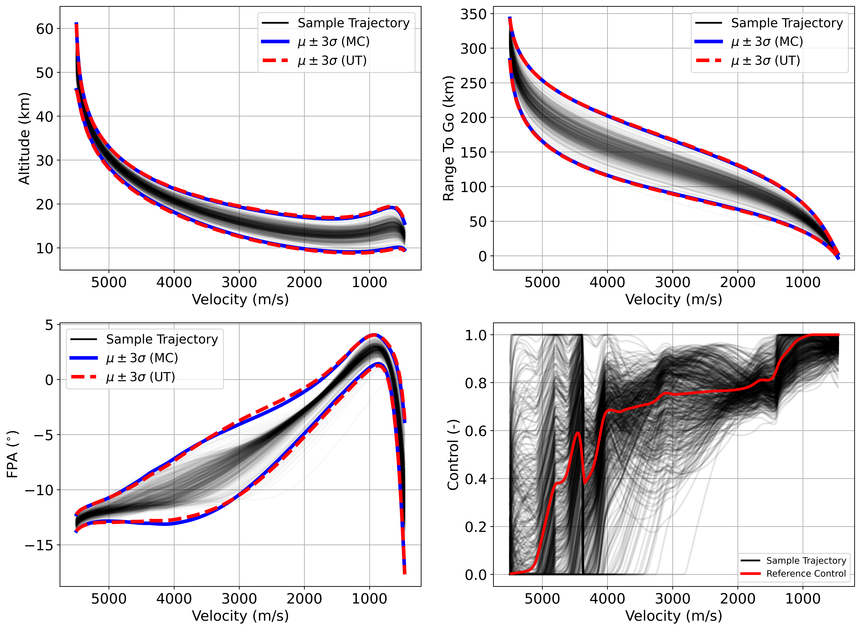
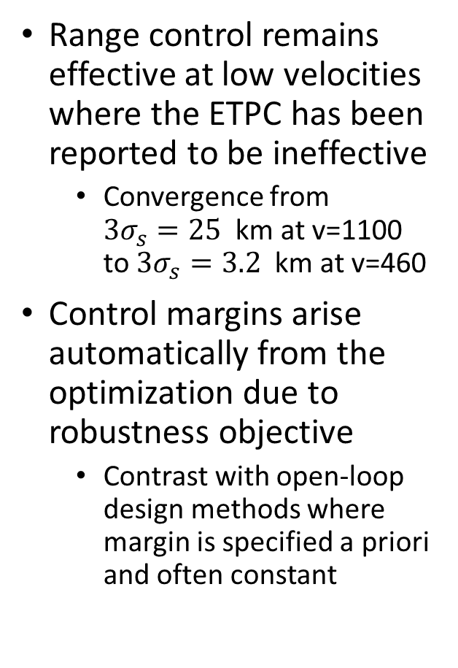
Main Results
Range control remains effective at low velocities where the ETPC has been reported to be ineffective
Convergence from $3σ_{s}=25$ km at v=1100 to$3σ_{s}=3.2$ km at v=460
Control margins arise automatically from the optimization due to robustness objective
Contrast with open-loop design methods where margin is specified a priori and often constant
Notes:
The unscented transform is sufficiently accurate to generate solutions that meet the requirements

Slide 22
SRP-Based Guidance Requirements
For mission with a pinpoint landing requirement, the entry guidance requirement(s) must be based on the propellant load and powered descent guidance chosen
No wind drift on chute, but now vehicle must carry sufficient propellant to deliver any state within ignition ellipse to the target
Entry Interface
Powered Descent
PDF
Ignition occurs at supersonic velocity
Propellant to land at target
Pinpoint Landing
Notes:
In general, guidance requirements for entry are flowed backward from the following phases based on timeline margin, landing footprint, etc.
Current generation essentially has to accept some error, due to the ellipse size at chute deploy growing before the ground.
Basic idea is that the entry guidance will do as well as it can to reduce the dispersions, but it can also seek to transition to PD at the optimal “time” (state). The optimal state will depend on the descent guidance that is chosen.

Slide 23
Contributions
Characterized propellant optimal entry trajectories via two-phase optimal control
Noyes, C.D., Wolf, A., and Benito, J. High Ballistic Coefficient Mars EDL With Supersonic Retropropulsion, AAS Guidance and Controls Conference, 2017.
Developed an entry guidance algorithm designed to synergize with a chosen powered descent guidance algorithm to minimize predicted propellant consumption
Noyes, C.D., and Mease, K.D., Entry Guidance for Propellant Optimal Powered Descent Ignition on Mars, AIAA/AAS Astrodynamics Specialist Conference, 2020.
Notes:
One major result is that the optimal ignition altitudes are quite low despite being far from the target (i.e. very shallow).
A safety constraint may be used to prevent very low ignitions; results indicate then that an altitude trigger may be near optimal

Slide 24
Conclusions
Entry guidance algorithms to address two distinct problems in Mars EDL were introduced
The results indicate the robust optimal guidance could support higher elevation landings than achieved to date while also improving range robustness
Same computational complexity as MSL, implementable on current generation hardware

Slide 25
Future Work
Velocity-varying gains computed by a method other than joint optimization in the ROCP (e.g. LQR)
Nonlinear control laws in place of the linear state feedback law
Address lateral control

Slide 26
Questions and Discussion

Slide 27
Backup Slides

Slide 28
Reference tracking entry guidance performance can be improved in two ways:
Improve the feedback control design
Improve the reference trajectory design

Slide 29
The literature on reference tracking control laws for Entry Guidance is vast
LQR, Sliding Mode, Observer-based, (N)MPC, etc.
The literature on how to (optimally) design a reference trajectory is not
Most work in the area is on optimal control of nominal trajectory
Ad hoc margins are applied to increase robustness
Robust optimal control offers a way to incorporate the control law and determine an optimal reference for the closed-loop dynamics

Slide 30
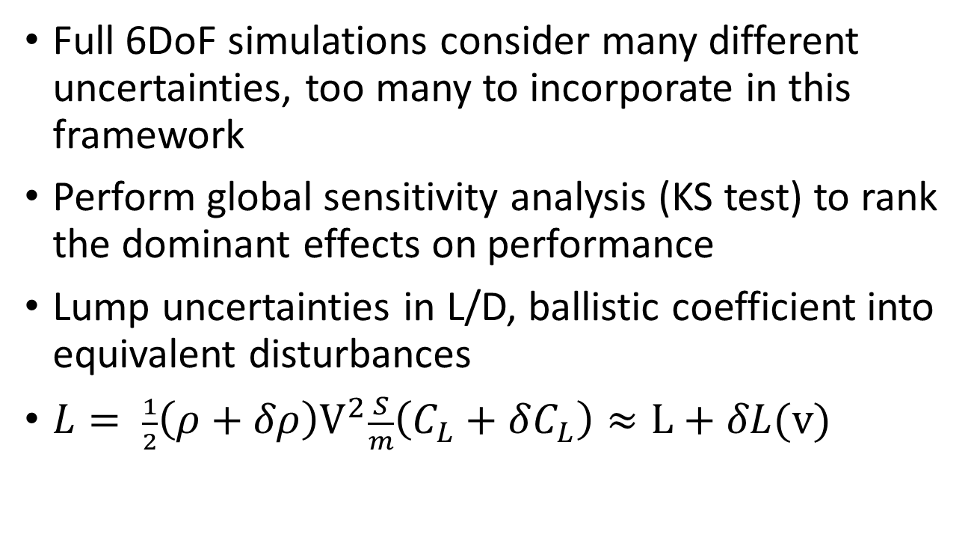
Dimension Reduction
Full 6DoF simulations consider many different uncertainties, too many to incorporate in this framework
Perform global sensitivity analysis (KS test) to rank the dominant effects on performance
Lump uncertainties in L/D, ballistic coefficient into equivalent disturbances
$L= \frac{1}{2}{\left(ρ+δρ\right)V}^{2}\frac{S}{m}\left(C_{L}+δC_{L}\right)≈L+δL(v)$
Notes:
Something not pursued but maybe necessary to incorporate other effects (stochastic variations)

Slide 31

DDP Convergence
Retaining $f_{uu}$ achieves DDP like convergence at LQR computation times

